Slide 1
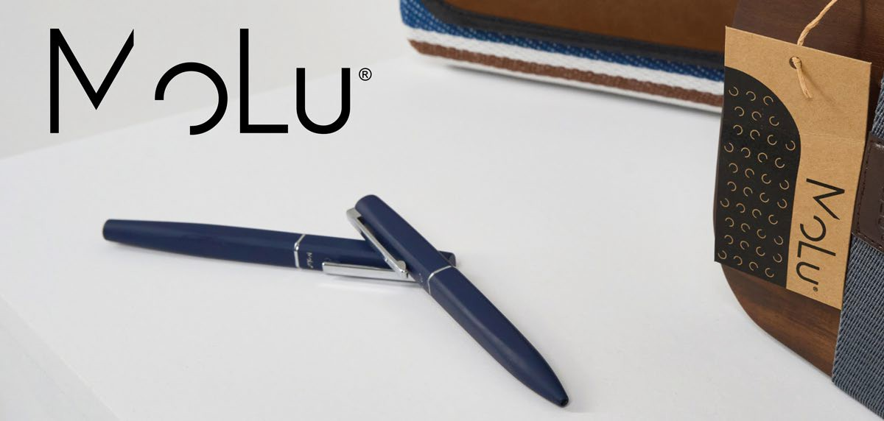
4412
ECO
RECYCLED STAINLESS STEEL
2 YEARS HIGH QUALITY WARRANTY MATERIALS
MoLu Stainless steel ballpoint pen Cape Coral
Our elegant, eco-friendly, and silver MOLU metal ballpoint pen. This exquisite writing instrument features high-quality craftsmanship from recycled metal and a matte brushed finish, giving it a luxurious look and feel. The chrome-colored clip and click mechanism add additional
refinement and functionality to the design.With the Parker large-capacity refill, the MOLU ballpoint pen offers a smooth and pleasant writing experience, perfect for long writing sessions. The refill function allows you to easily replace the cartridge, making this pen a long-lasting companion.A special highlight of this ballpoint pen is the option for elegant engraving. You can have your logo precisely and permanently engraved on both the barrel and the clip. This makes the MOLU ballpoint pen a perfect personalized gift or a premium promotional item for your
company.
17,7 × 3,5 × 3 cm G1
4 × 0,6
ECO
RECYCLED STAINLESS STEEL
2 YEARS WARRANTY
HIGH QUALITY MATERIALS
4385
MoLu Writing set Cap d'Agde
This writing set impresses with its unique triangular shape, which is not only stylish but also fits perfectly in the hand. The unique design, developed according to the principles of the golden ratio, perfectly combines aesthetics and ergonomics.The MOLU pens are made of high-quality metal, giving them an elegant appearance and ensuring durability and robustness. Thanks to the smooth metal surface, your logo can be precisely and permanently engraved on the barrel, making these pens ideal as personalized gifts or premium promotional items.Each pen is equipped with a Parker large-capacity refill, providing a smooth and comfortable writing experience. The MOLU pen is available as both a ballpoint pen and a rollerball pen, allowing you to choose the writing style that best suits your needs. With the refill function, you can easily replace the cartridges and continue using your favorite pen.
Whether in the office, at school, or for personal notes – the MOLU pen set is the ideal companion for anyone who values quality and design.
17,7 × 7,1 × 3 cm L4
4 × 0,5
ECO
RECYCLED TWISTED STAINLESS MECHANISM,
STEEL SOFT TOUCH
2 YEARS HIGH QUALITY WARRANTY MATERIALS
3933
MoLu Writing set Sainte-Maxime
Exclusive writing set, consisting of an elegant ballpoint pen and a stylish rollerball pen. Both writing instruments are made from recycled stainless steel and feature a comfortable rubber surface for easy handling. The sophisticated gun-metal accents give the set a modern and refined look.The engraved Molu logo on both pens highlights the high-quality craftsmanship and exclusivity of this set. Your logo is subtly yet effectively placed
to the right of the clip on both writing instruments, ensuring your brand is always present.This writing set is not only a practical tool for everyday use but also a stylish accessory that combines professionalism and sustainability. Ideal as a gift or promotional item, it is guaranteed to leave a lasting impression.
17,7 × 7,1 × 3 cm L4
4 × 0,5

