Slide 1
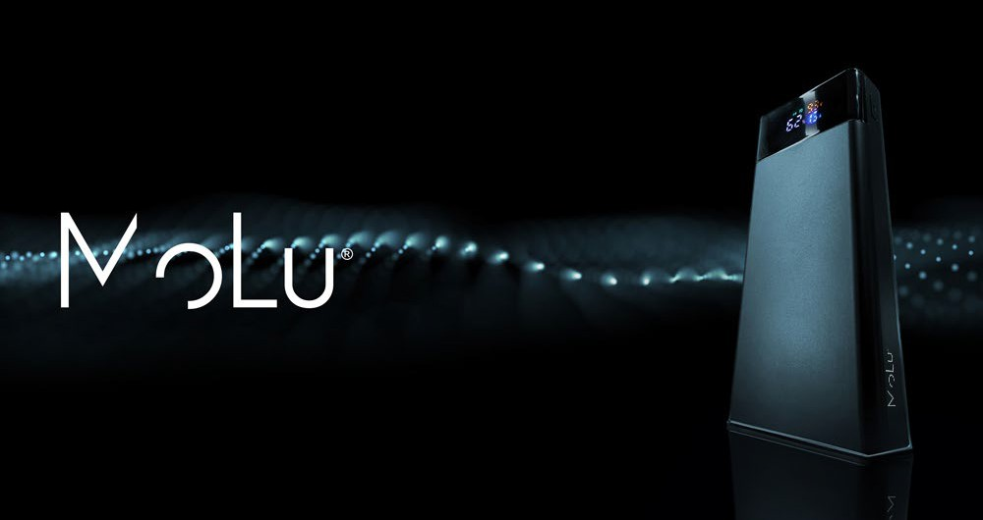
PLASTIC
USB TYPE-A, USB TYPE-C, iOS
74W POWER,
20.000 MAH
LED LIGHTING, CLEAR SOUND, 3 STEP BRIGHT- NESS
2 YEARS WARRANTY
HIGH QUALITY MATERIALS
3982
MoLu Powerbank Marbella
The ultimate mobile power solution with our power bank, offering an impressive capacity of 20,000 mAh. This powerful power bank is equipped with a fast-charging function, ensuring your devices are ready to use in no time.With two USB ports, a USB-C port, and an integrated iOS cable, it provides versatile charging options for all your devices. The smart LCD display shows the current charging status and other important information at a glance.Your personal logo is prominently printed on the power bank, providing a striking and professional presentation of your brand. This
power bank is the ideal promotional gift or practical accessory for everyday use, impressing with its functionality and high-quality craftsmanship.
14,2 × 6,6 × 2,7 cm T4
4 × 4

